Slide 1
CUSTOMER SEGMENTATION (Clustering Project)
-RESHWAK
-Triveni Zoting
-Ritesh Singh
-Snehitha Nalam

Slide 2
INTRODUCTION
Customer segmentation is the process of dividing customers into groups based on common characteristics so companies can market to each group effectively and appropriately. Segmentation allows marketers to better tailor their marketing efforts to various audience subsets.
Customer segmentation requires a company to gather specific information -data- about customers to analyze it to identify patterns that can be used to create segments.

Slide 3
PROBLEM STATEMENT
Customer segmentation helps a business to modify its product based on its target customers from different types of customer segments. For example, instead of spending money to market a new product to every customer in the company’s database, a company can analyze which customer segment is most likely to buy the product and then market the product only on that particular segment.The target of this project is to perform clustering to summarize customer segments.
In this project, we will perform an unsupervised clustering of data on the customer's records from a groceries firm's database.

Slide 4
DATA DESCRIPTION
ATTRIBUTES
PRODUCTS
MntWines: Amount spent on wine in last 2 years
MntFruits: Amount spent on fruits in last 2 years
MntMeatProducts: Amount spent on meat in last 2 yearsa
MntFishProducts: Amount spent on fish in last 2 years
MntSweetProducts: Amount spent on sweets in last 2 years
MntGoldProds: Amount spent on gold in last 2 years
People
ID: Customer's unique identifier
Year_Birth: Customer's birth year
Education: Customer's education level
Marital_Status: Customer's marital status
Income: Customer's yearly household income
Kidhome: Number of children in customer's household
Teenhome: Number of teenagers in customer's household
Dt_Customer: Date of customer's enrollment with the company
Recency: Number of days since customer's last purchase
Complain: 1 if the customer complained in the last 2 years, 0 otherwise

Slide 5
DATA DESCRIPTION
ATTRIBUTES
PLACE
PROMOTION
NumDealsPurchases: Number of purchases made with a discount
AcceptedCmp1: 1 if customer accepted the offer in the 1st campaign, 0 otherwise
AcceptedCmp2: 1 if customer accepted the offer in the 2nd campaign, 0 otherwise
AcceptedCmp3: 1 if customer accepted the offer in the 3rd campaign, 0 otherwise
AcceptedCmp4: 1 if customer accepted the offer in the 4th campaign, 0 otherwise
AcceptedCmp5: 1 if customer accepted the offer in the 5th campaign, 0 otherwise
Response: 1 if customer accepted the offer in the last campaign, 0 otherwise
NumWebPurchases: Number of purchases made through the company’s website
NumCatalogPurchases: Number of purchases made using a catalogue
NumStorePurchases: Number of purchases made directly in stores
NumWebVisitsMonth: Number of visits to company’s website in the last month

Slide 6
TABLE CONTENTS
1.EDA
2.MODEL BUILDING
3.MODEL EVALUATION
4.DEPLOYMENT

Slide 7
Exploratory Data Analysis (EDA)

Slide 8
Exploratory Data Analysis(EDA)
Exploratory Data Analysis (EDA) is a crucial initial step in data science projects. It involves analyzing and visualizing data to understand its key characteristics, uncover patterns, and identify relationships between variables refers to the method of studying and exploring record sets to apprehend their predominant traits, discover patterns, locate outliers, and identify relationships between variables. EDA is normally carried out as a preliminary step before undertaking extra formal statistical analyses or modeling. Here are some of the key reasons why EDA is a critical step in the data analysis process:
Understanding Data Structures
Identifying Patterns and Relationships
Detecting Anomalies and Outliers
Facilitating Data Cleaning

Slide 9
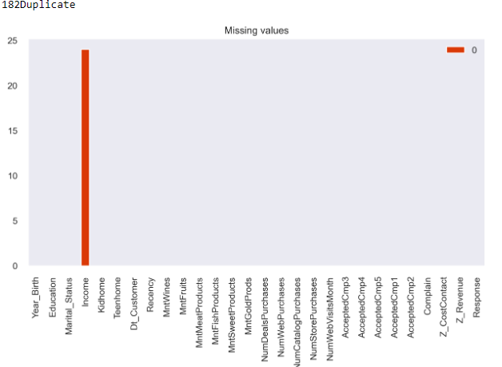
Data Cleaning
Observation from the screenshot shows us that we have 182 duplicates and missing values in income feature.
We deleted duplicated records.
We replaced missing values in income features with zero because if income zero means they might be unemployed.

Slide 10

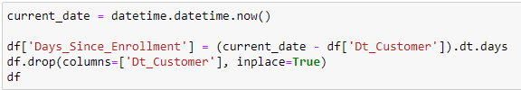


Manipulating feature columns:
We converted year of birth feature into Age
We converted dt_customer into days since enrolment
we added both kidhome and teenhome into kids feature
We added all the accetedcmp features into one total accepted cmp

Slide 11

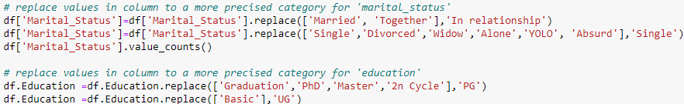
Manipulating feature columns:
We added all the modes of purchase into one ‘total Num of purchase’ feature.
Marital Status feature manipulation:
We converted married and together into ‘in relationship’.
We converted single, divorced etc., into ‘single’.
Education feature manipulation:
We converted graduation, PhD education etc., into ‘PG’.
We converted basic education into ‘UG’.

Slide 12
Manipulating feature columns:
We added all the item expense into one feature as total expense
We deleted these feature columns after manipulation of all the feature columns.
Now we have 12 columns instead of 29 columns which will make deploying easy.

Slide 13
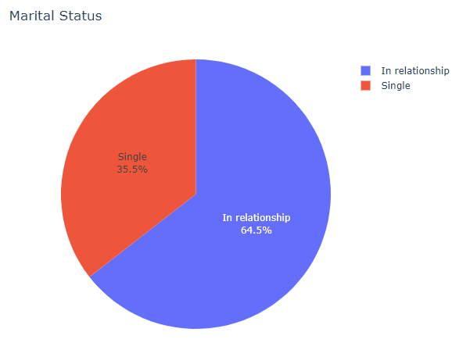
Visualizing data:
64.5% people are in relationship.
35.5% people are single.

Slide 14
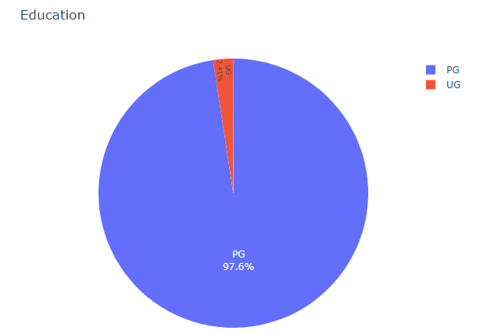
Visualizing data:
97.6% of people are post graduates.
2.4% of people are under graduates(basic education)

Slide 15
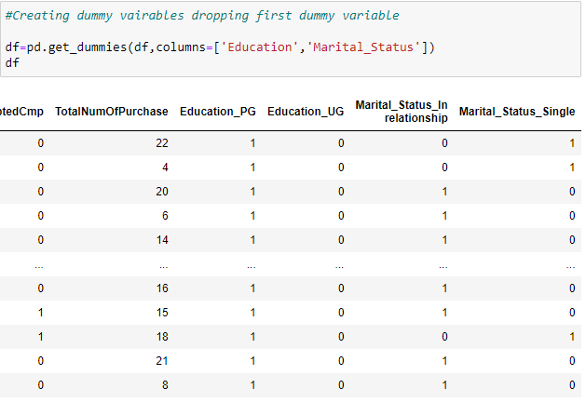
Creating dummy variables for Education and marital status features:
We created dummy variables columns which added 4 more columns and deleted education and marital status columns which makes 14 columns (features) now.

Slide 16
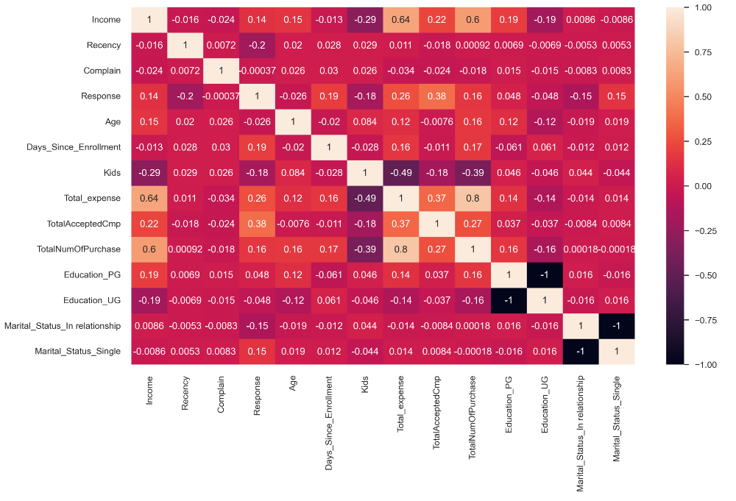
Visualizing and analysing data:
We can see correlation between all the features in this slide.

Slide 17
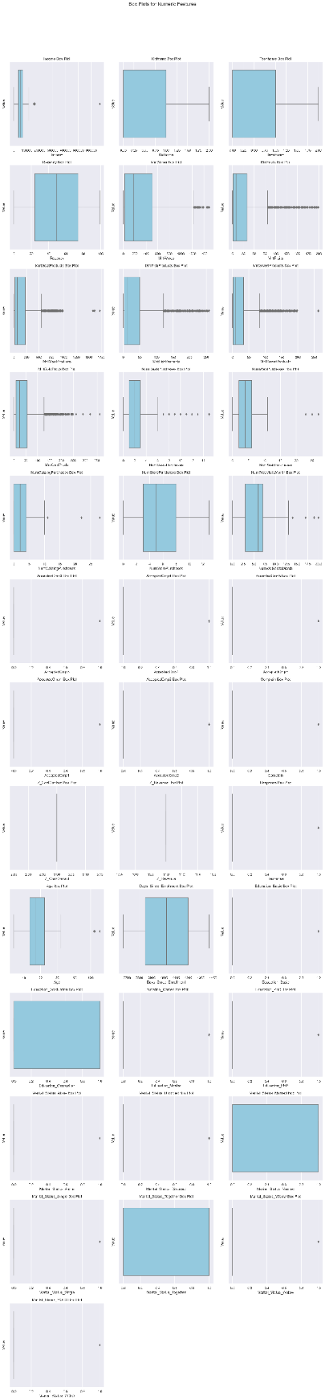
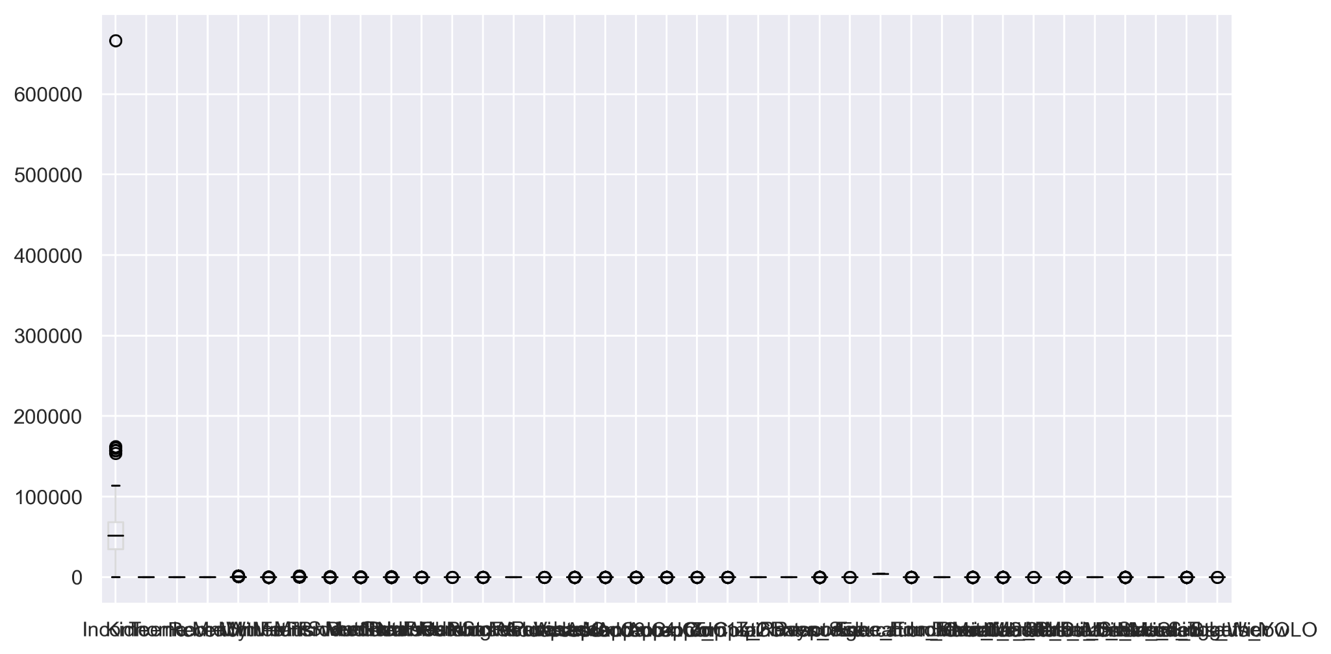
Visualizing outliers in data:
Box plot to detect outliers: we can see lots of outliers in almost every feature.
We are capping outliuers in only income and age columns

Slide 18
Model Building

Slide 19
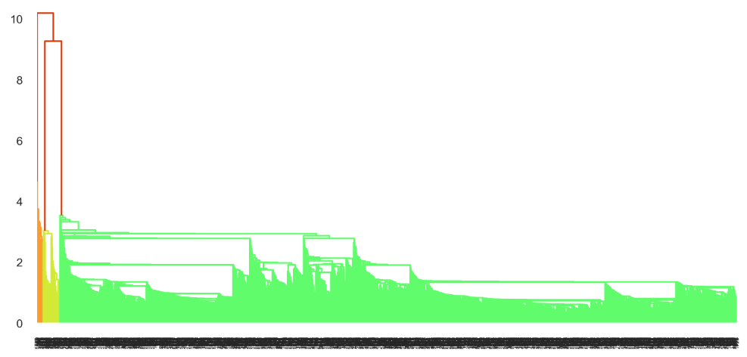
Hierarchical clustering:
Visualizing Single linkage HC
3 clusters Orange, Yellow and Green

Slide 20
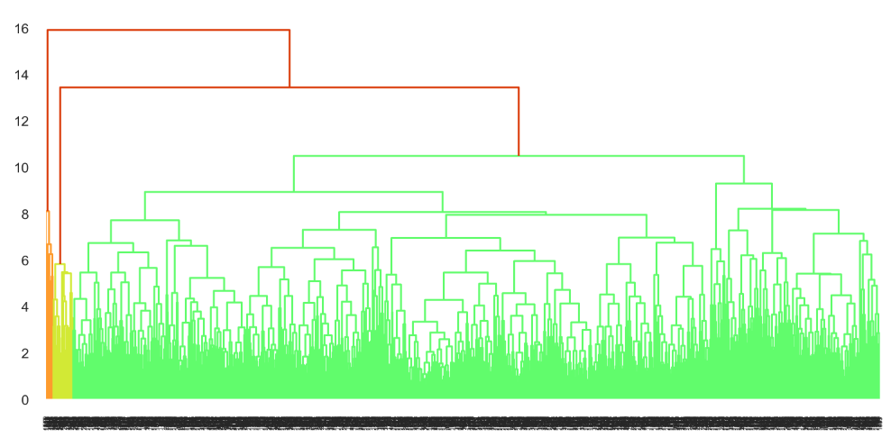
Hierarchical clustering:
Visualizing complete linkage HC
3 clusters Orange, Yellow and Green

Slide 21
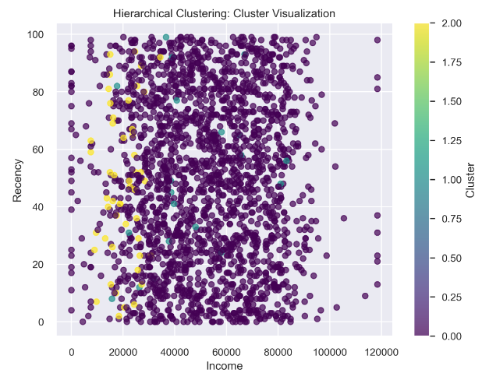
Hierarchical clusters visualization:
Clusters visualizing between income and recency columns there are 3 clusters as we can see.
We got HC silhouette score as 0.57

Slide 22
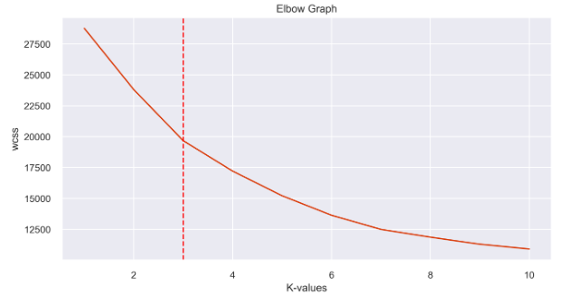
K-means clustering:
Elbow Graph to find clusters for k-means clustering.
We chose 3 clusters from elbow graph.

Slide 23
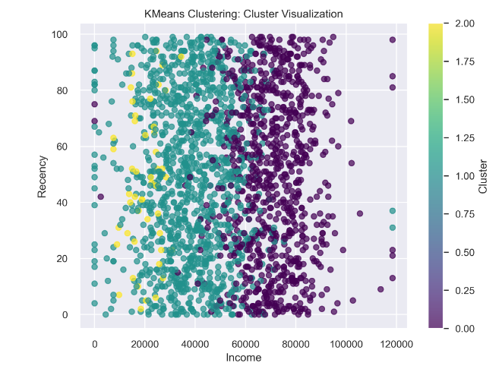
K-means clusters visualization:
Scatter plot between income recency after cluster prediction.
We can see 3 clusters made from k-means.
We got k-means cluster silhouette score as .021.

Slide 24
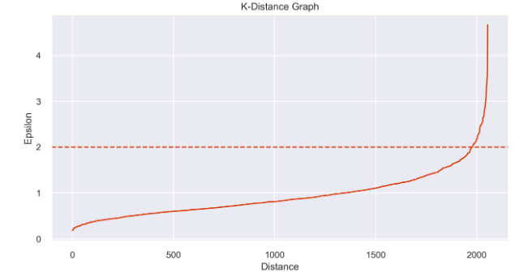
DBSCAN Clustering:
K-distance graph for dbscan.
We chose 2 has epsilon value by seeing elbow of this graph.

Slide 25
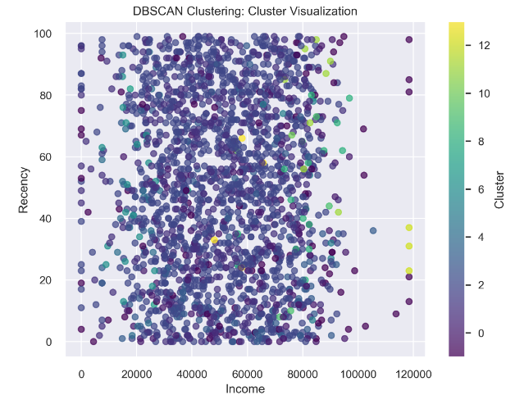
DBSCAN Clusters visualization:
Scatter plot between income and recency after dbscan cluster using eps=2.2 and mini_samples=5.
We got dbscan silhouette score has 0.20.

Slide 26
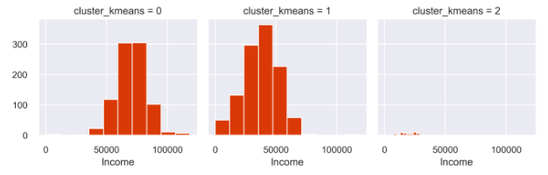
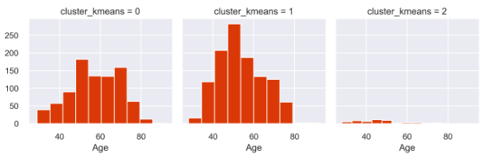
Visualizing k-means clusters per feature:
This 1st screenshot shows income clusters with k-means.
we used decision tree classifier to segregate clusters, We got a accuracy of 97%.
This 2nd screenshot shows age clusters with k-means.
Looking at these clusters divided properly we decided to choose k-means for deployment.

Slide 27
Deployment

Slide 28
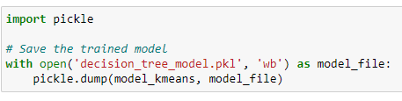
Deployment file saving:
We used pickle library to save trained model has pickle file.

Slide 29
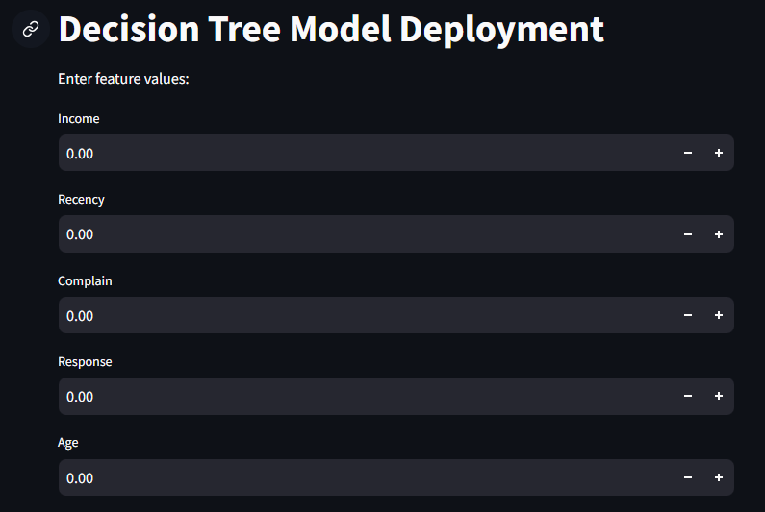
Deployment results:
This is layout we get when we deploy the model.
We can see space where we need to fill the feature values to predict clusters.

Slide 30
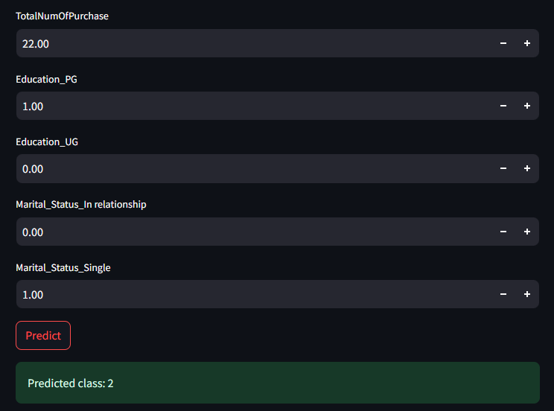
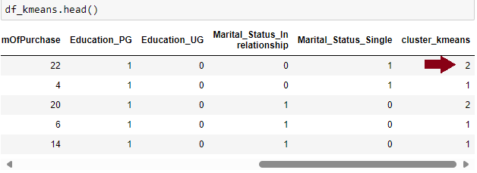
Comparing deployment results:
1st slide shows prediction we did in k-means model building.
Same values when we put in deployment model we getting the same ‘2’ cluster so over deployment model is working has intended.

Slide 31
Project Outro

Slide 32
CHALLENGES FACED:
Data Quality Issues: Incomplete, outdated, or inaccurate data can lead to incorrect segmentation. Which may result in ineffective marketing strategies.
High Dimensionality of Data: The large number of variables or features in customer data can make the segmentation process complex and computationally intensive.
Choosing the Right Segmentation Method: Selecting the appropriate algorithm (e.g., dbscan,k-means, hierarchical clustering) and the optimal number of segments can be difficult.
Over-Segmentation: Creating too many segments can lead to overly granular groups that are difficult to target and manage.
Integration of Different Data Sources: Combining data from various sources, such as CRM systems, social media, and sales databases, can be challenging due to differences in data formats and structures.
Ensuring Privacy and Compliance : Managing and processing customer data must comply with regulations like GDPR or CCPA.
Dynamic Nature of Customer Behavior: Customer preferences and behaviors can change over time, making static segmentation models less effective.

Slide 33
HOW TO OVERCOME IT:
Data Quality Improvement: Regularly clean and update data to eliminate inaccuracies and ensure consistency. Use automation tools for data cleansing and validation.
Advanced Analytical Tools: Implement machine learning algorithms and advanced statistical tools to improve the accuracy and depth of segmentation.
Integration of Diverse Data Sources: Combine data from various sources (e.g., online behavior, purchase history, demographics) to create a more comprehensive view of customers.
Personalization and Customization: Develop personalized marketing strategies for each segment based on the insights derived from segmentation analysis. Tailor communication and offers to meet the specific needs of each group.
Continuous Monitoring and Updating: Regularly review and adjust segmentation models to reflect changes in customer behavior and market conditions.
Cross-Department Collaboration: Encourage collaboration between marketing, sales, and customer service teams to ensure that segmentation strategies are effectively implemented and aligned with overall business goals.

Slide 34
CONCLUSION:
we successfully applied unsupervised clustering techniques to categorize customers based on their purchasing behavior, demographics, and engagement with the company.
The segmentation provided valuable insights into distinct customer groups, each with unique characteristics and needs.
the business can now tailor its marketing strategies more effectively, focusing on specific customer groups with personalized campaigns and product offerings.
This approach is expected to enhance customer satisfaction, increase loyalty, and ultimately drive higher revenue.

Slide 35
Thank You !!

